Slide 1
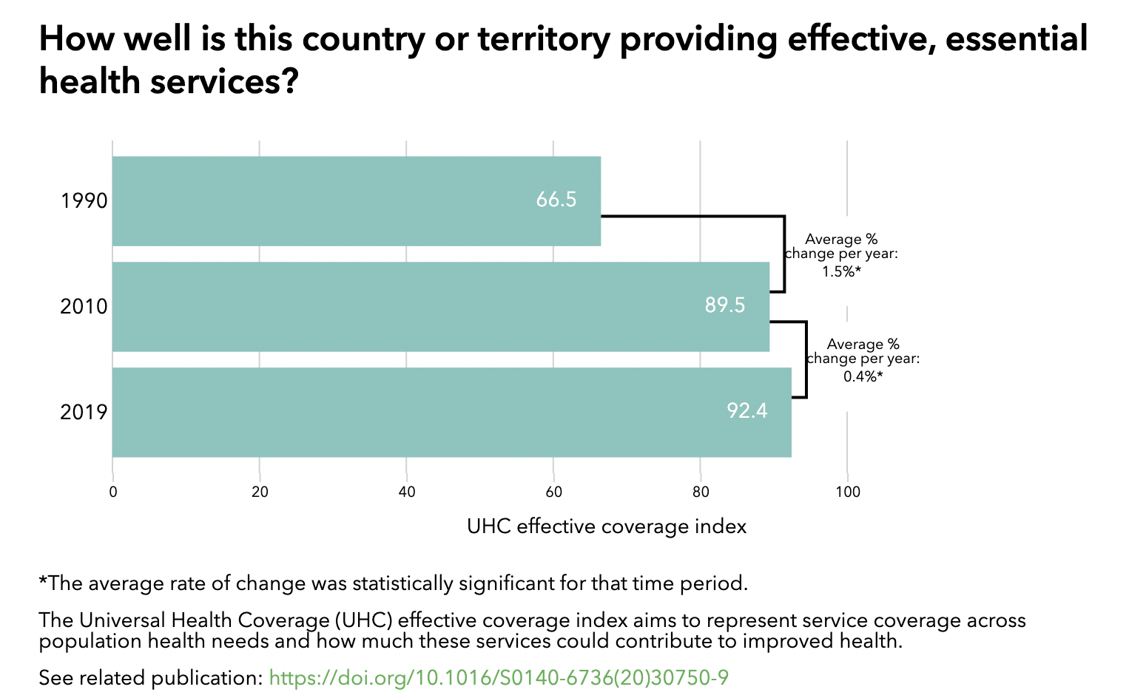
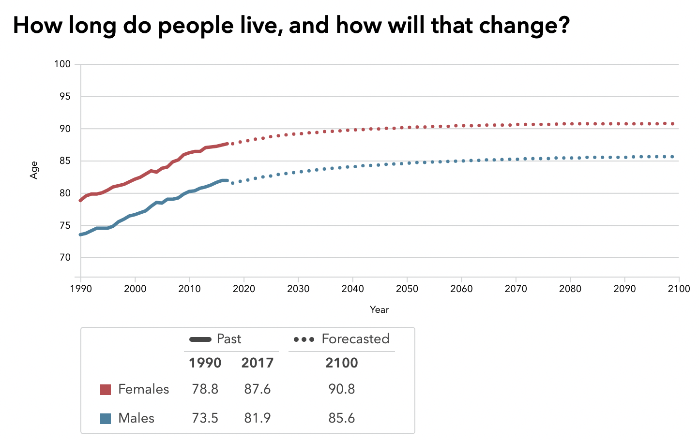
Performance Evaluation of the Singapore Healthcare System
Introduction
Results
Singapore is a city-state in Southeast Asia, which has made remarkable economic progress since its independence in 1964, which has brought about many positive changes in healthcare enabling the local healthcare to be one of the best in the world. An evaluation of the system is critical for us to understand the achievement the country has made. Here we use the Commonwealth Fund Framework to assess the performance of the healthcare system, in which high performance is defined in 5 dimensions, including high quality care, access and equity for all, efficient care, system and workforce innovation and improvement, and lastly long, healthy and productive lives. The framework is helpful to identify best practices in healthcare, which makes it the most suitable framework to analyse the Singapore healthcare system.
What are the major strategies to ensure quality of care?
What are the major innovations in the system?
Clinics regulated by Private Hospitals and Medical Clinics Act.
Professionals regulated by respective professional boards
Ministry of Health conduct patient survey for international benchmarking
Chronic Disease Management Program to ensure best practices
Beyond Healthcare 2020 strategy (2017)
regulatory “sandbox” for identifying and understanding new health care innovations (2018)
CareShield Life and ElderFund to optimise long-term cost (2020)
Introducing a pay-for-performance framework for public health goals
What are the major strategies to ensure efficiency?
Funding
Tax
MediShield for low-income
MediSave for everyone
Private insurance
Ranked 2nd in the world (EIU 2014)
~ 4% GDP (Singapore)
8% GDP (UK)
12% GDP (US)
Diverse funding for everyone and those in need
Remarkable achievement

